Slide 1



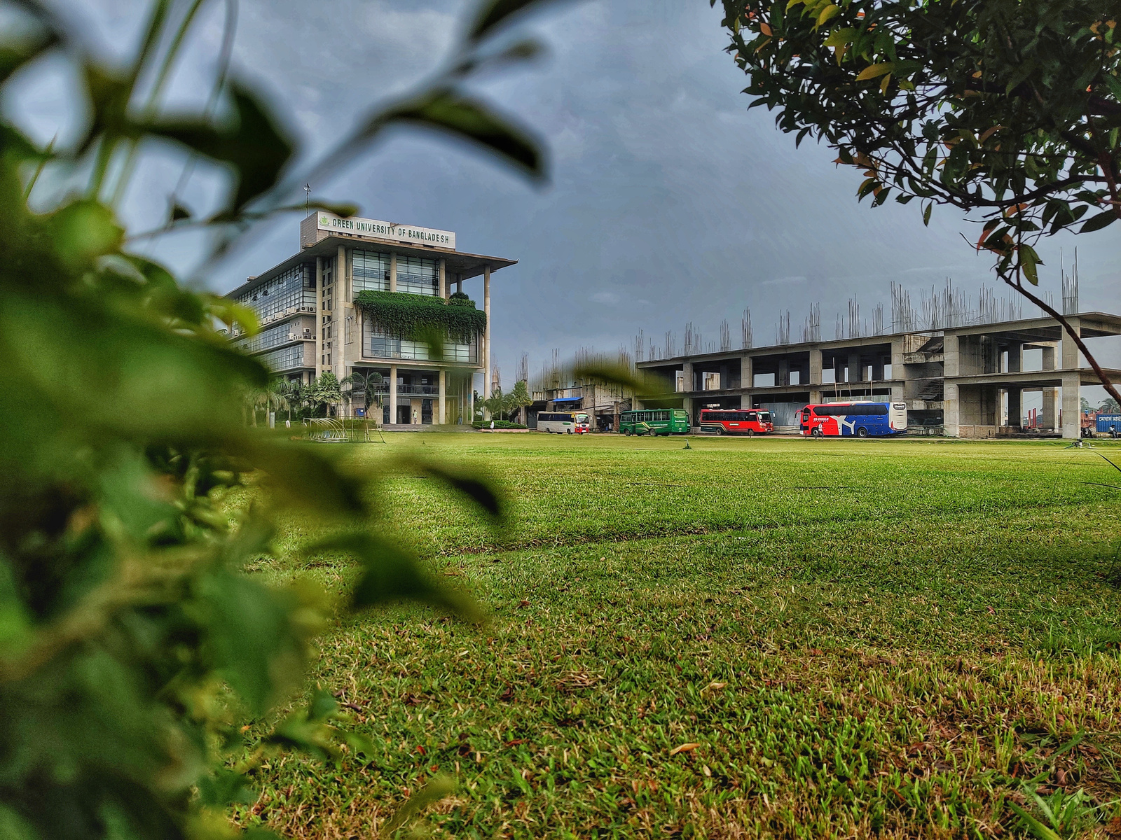


Green University of Bangladesh
Department Of Computer Science and Engineering(CSE)
Course Title: Electronic Devices and Circuits & Pulse Techniques
Course Code: EEE 203 Section: 221 D8
Presented by:
Md. Mahim Hossain
ID: 221902082
Presented to
Md. Nahian Rabbi Ushan
Lecturer, Dept. of EEE
Green University Of Bangladesh

Slide 2
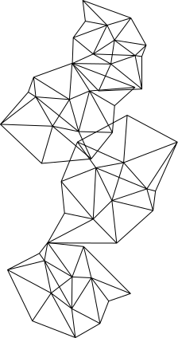

Content
1
MOSFET Writing Principle
2
MOSFET Characteristics
3
Three Problem of MOSFET
4
CMOS
5
CMOS Implementation

Slide 3
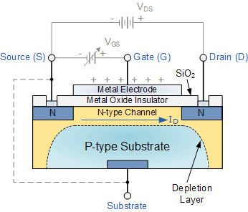
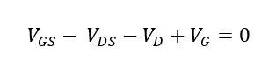
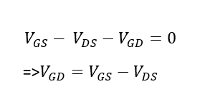
Writing Principle

Slide 4
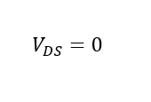
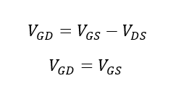
Case 01
Here,

Slide 5
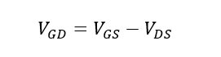
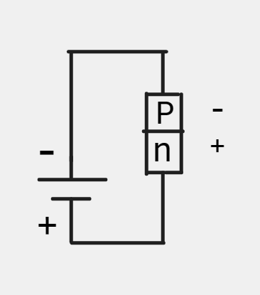
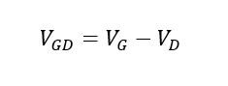
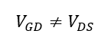
Case 02
Reverse

Slide 6
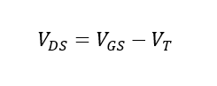
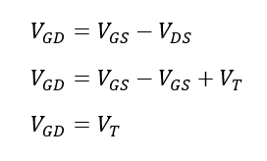
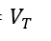
Case 03
Here,
= Pinch of Voltage

Slide 7
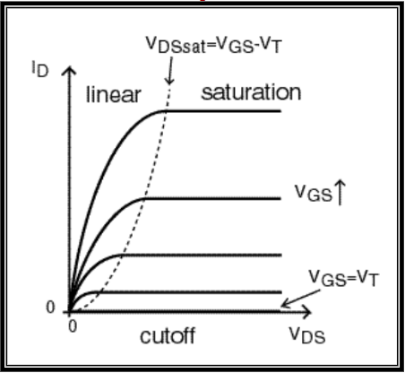
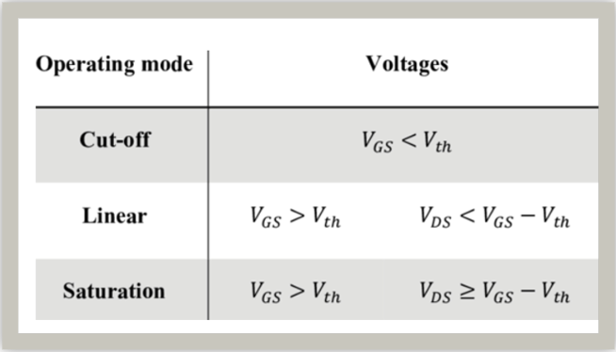
MOSFET Characteristics

Slide 8
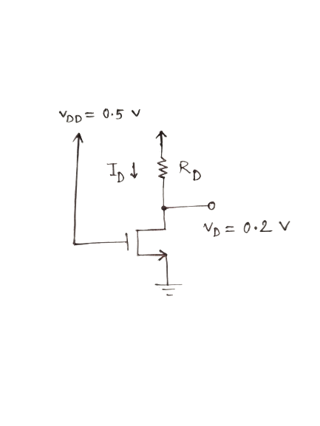
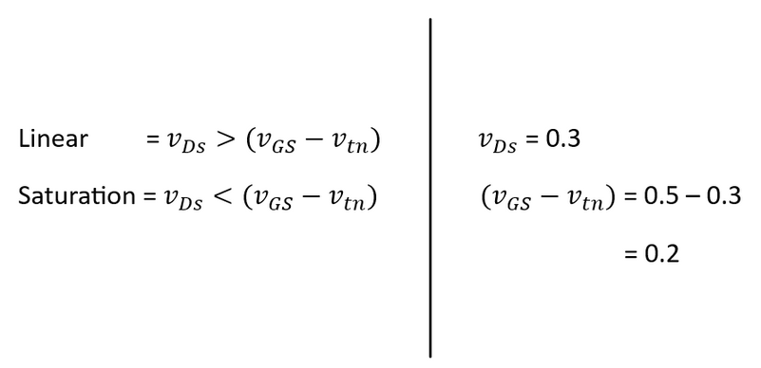
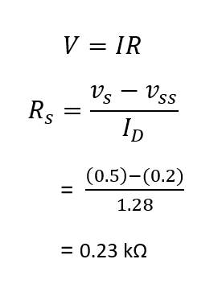
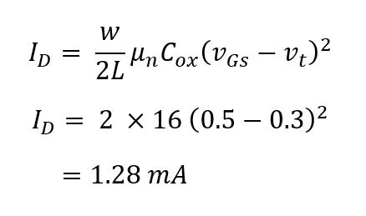
Problem 01

Slide 9
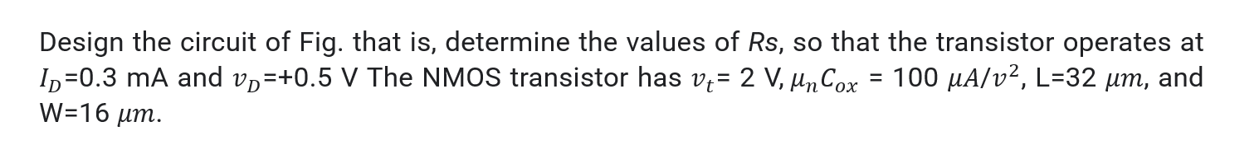
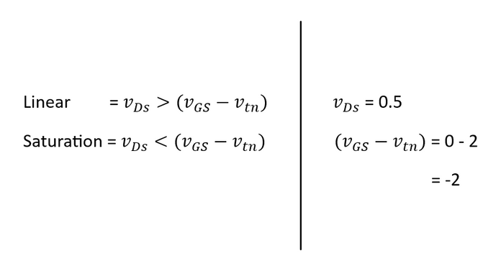
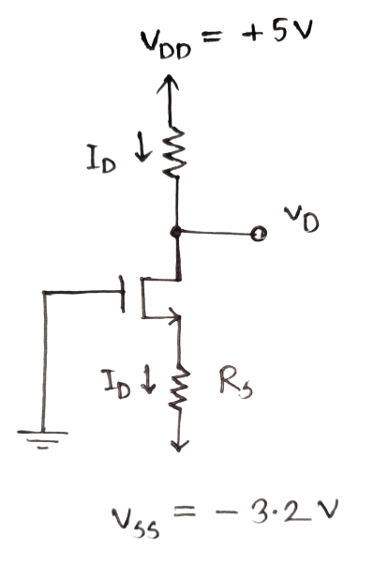
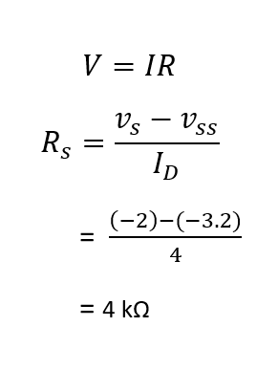
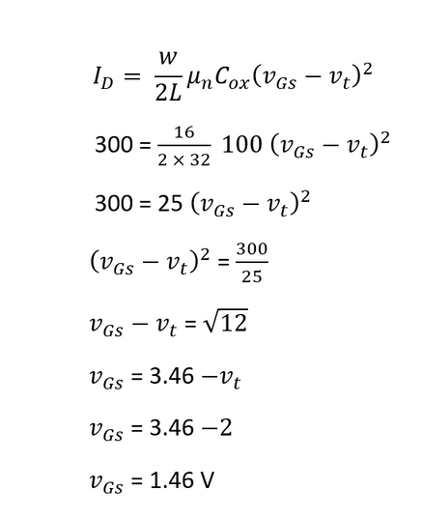
Problem 02

Slide 10

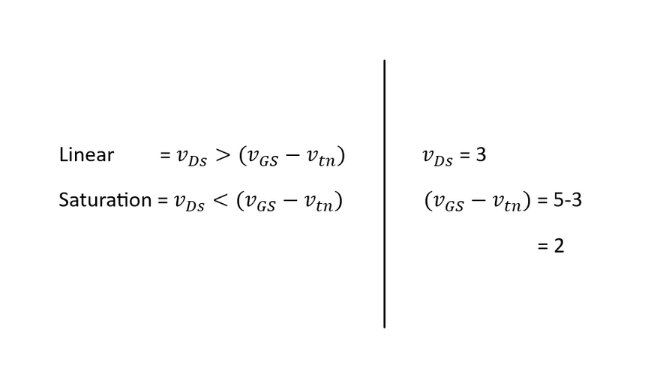
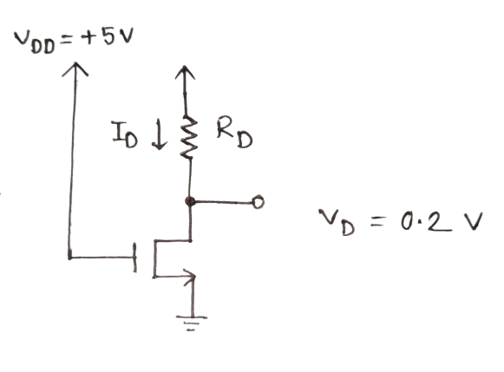
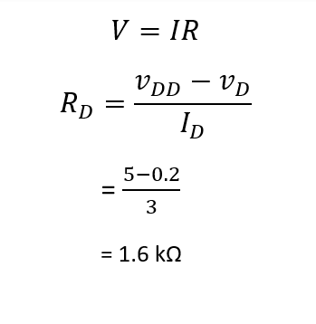
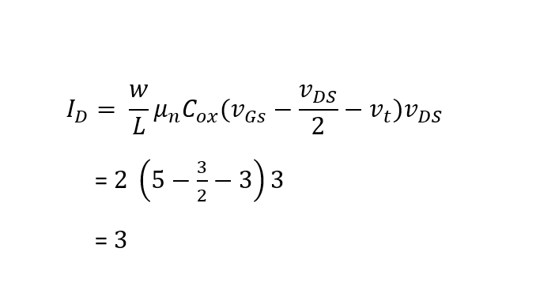
Problem 03

Slide 11
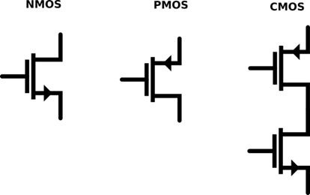
CMOS (Complementary Metal-Oxide-Semiconductor)
Complementary Metal-Oxide-Semiconductor relies on complementary pairs of p-type and n-type MOSFETs to perform logic functions in integrated circuits. This design, with its symmetrical and complementary nature, allows for low power consumption and efficient digital logic operations.
It use in :
Computers,
Digital cameras,
Mobile phones, and
Other electronic devices
Type of CMOS

Slide 12
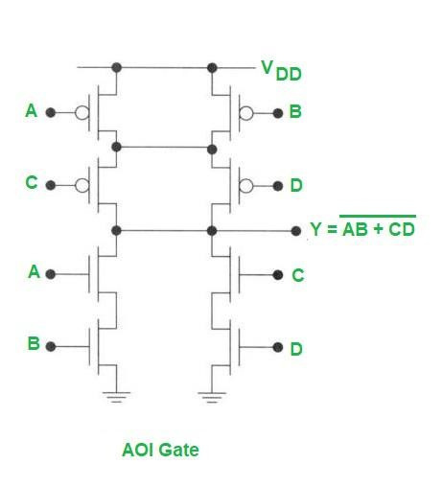
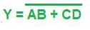
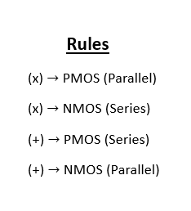
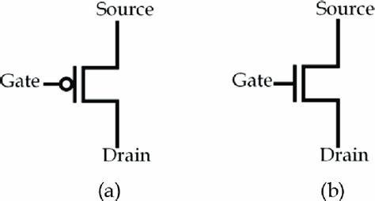
CMOS Implementation

Slide 13



Thanks for Watching
Md. Mahim Hossain
ID: 221902082
Contact
Any Question, Just Ask don't be shy
E-mail
faaiz.mahim@gmail.com
Phone
+880 18669-28533

